Slide 1

Webinar BELGA - WE MEDIA
Door Olivier Delbrouck en Lieven De Maertelaere

Slide 2
About Belga
Founded in 1920
100 years supplier of facts and services
Shareholders: DPG Media, EDA, IPM, Mass Transit Media, Mediafin, Mediahuis, Rossel, RTL Belgium, VRT
135 employees

Slide 3
Belga Newsroom
80 journalists , 50 regional correspondents and photographers, 30 other freelancers
News in text (almost 1.000 articles a day), image (photo/video), audio, infographics
Texts in Dutch and French, special projects in English
Newsdesks in Brussels and Sydney
Agenda Services

Slide 4
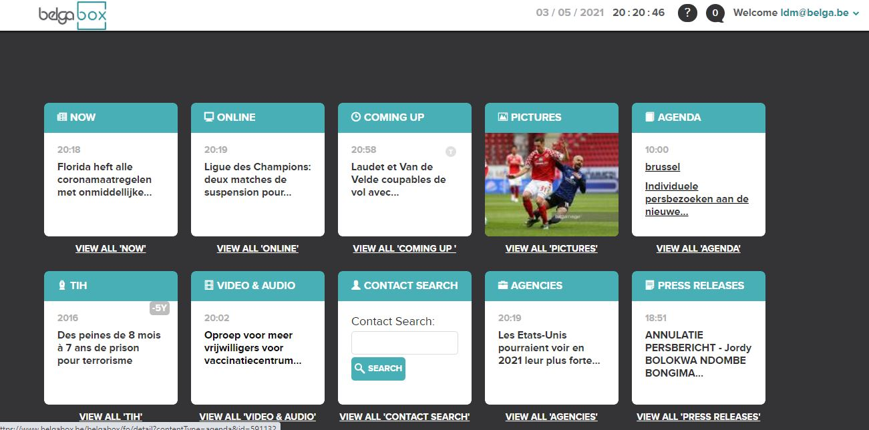
BelgaBox: tool for media

Slide 5
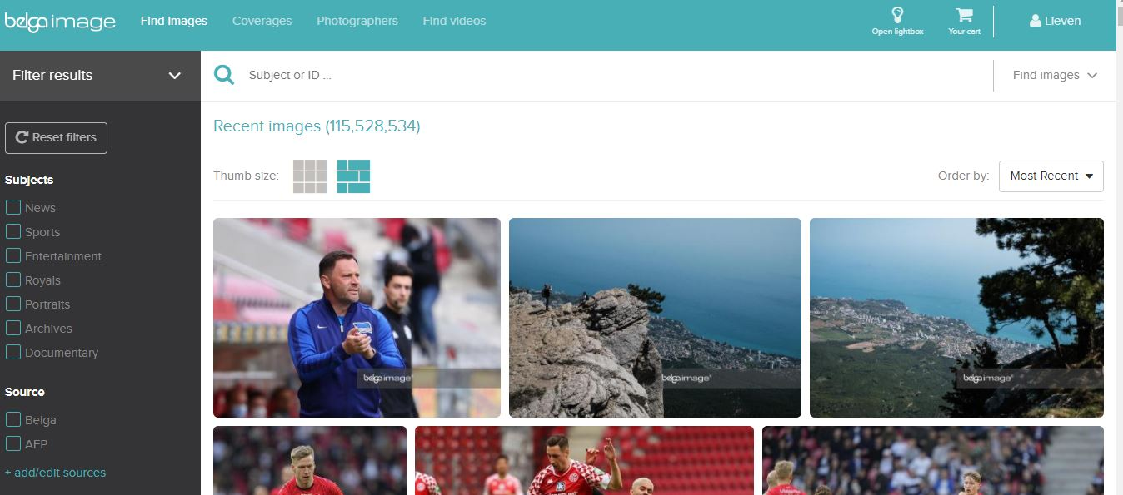
BelgaImage: millions of pictures and videos

Slide 6
Belga Services
News: text and images
Online Feeds: general or customised
Audio: radio news
PRpro: distribution of press releases
Newsroom: collaboration with Prezly

Slide 7
Belga Services
Workshops: press relations, mediatraining
Gopress / belga.press
Clients: media, enterprises, organisations, government customers

Slide 8
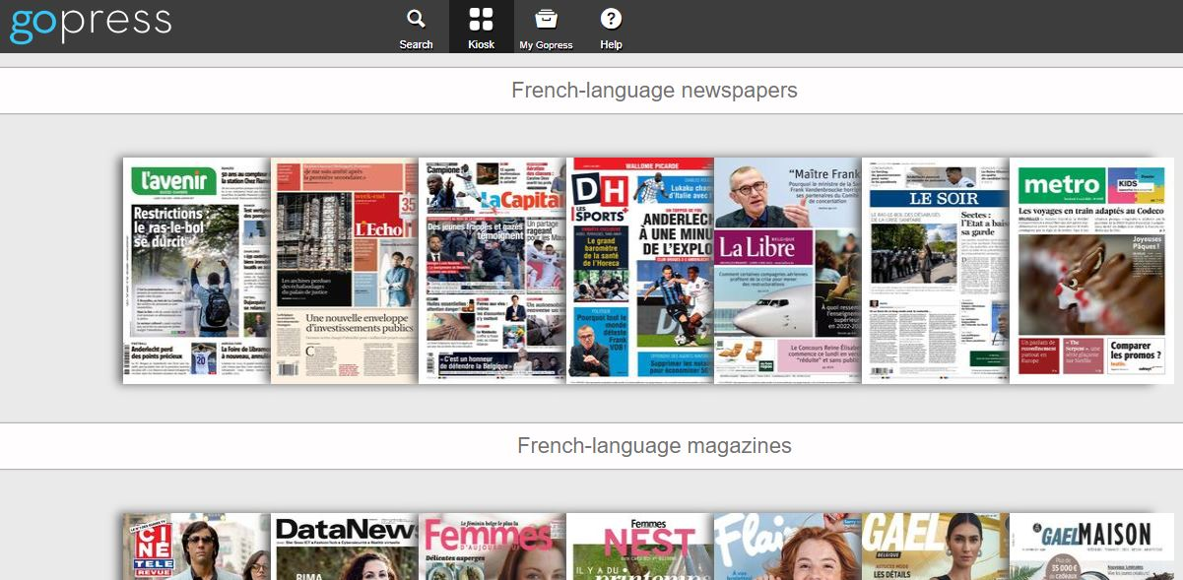
Gopress

Slide 9
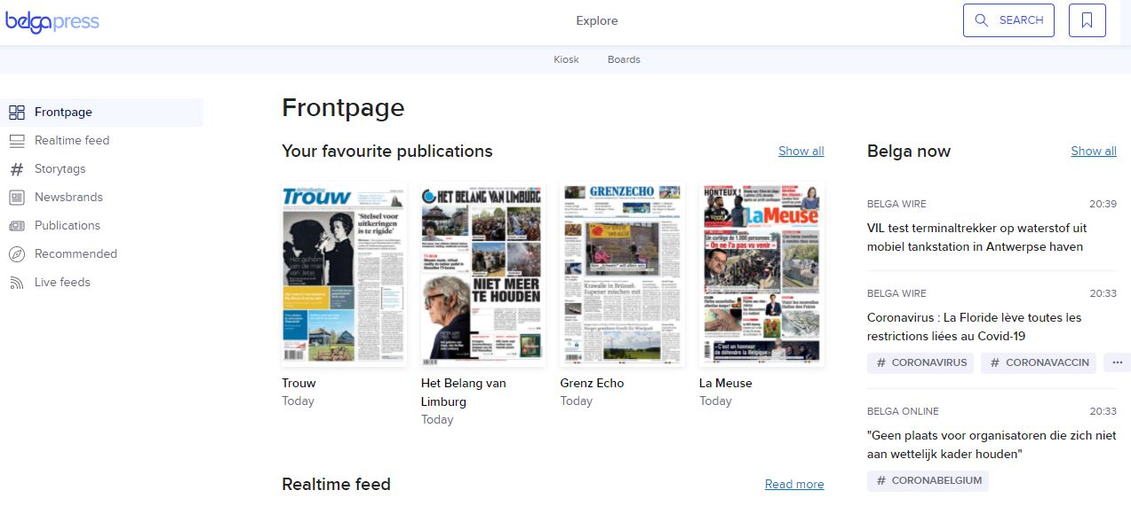
Belga.press

Slide 10
More info? ODE@belga.be / LDM@belga.be

